Slide 1

Invoice Design
Step by step Training
Author: Juan Vidal – Email: juanv@jbilling.com

Slide 2

Summary
What is an invoice design?
Why would you need to create an invoice?
What do you need to know to be able to create one?
Example
Little test

Slide 3
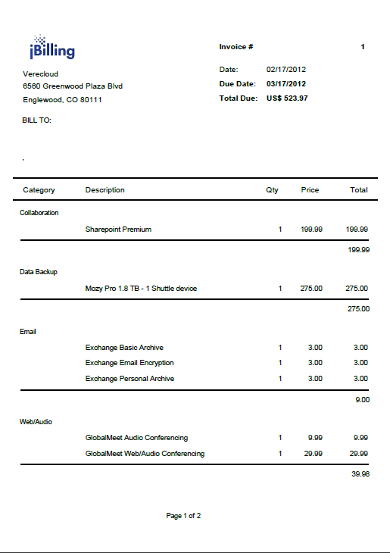
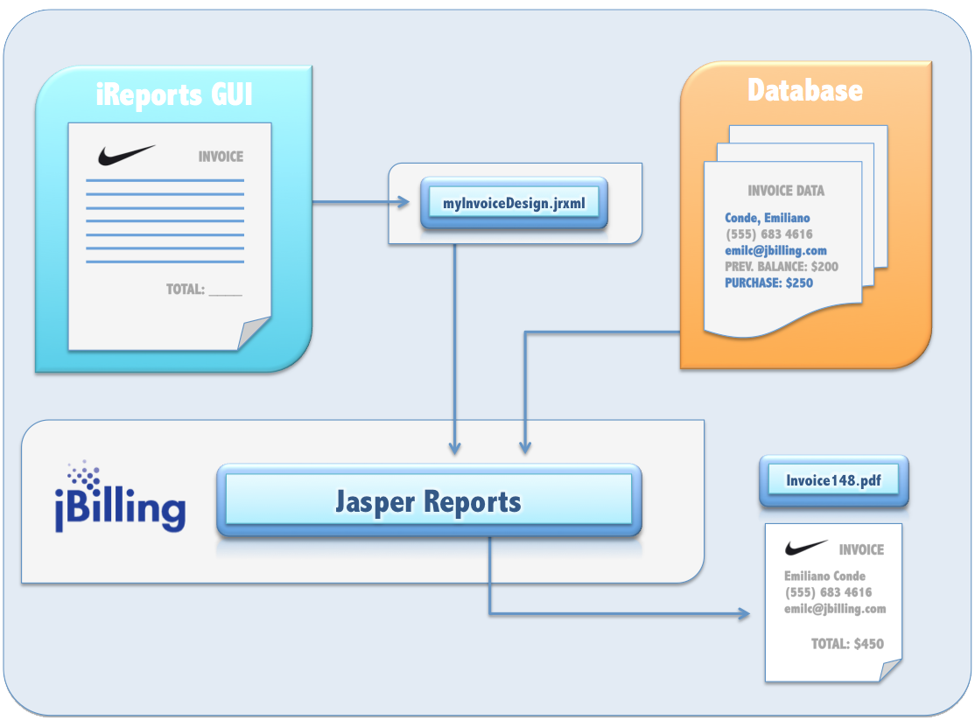
What is an invoice design?

Slide 4
Why would you need to create an invoice?
This is mainly done for companies. They requests us to create an invoice with a particular layout, logic and data in it. This varies between customers.

Slide 5
What do you need to know to be able to create one?
Invoice design
Configuration
Invoice directory
Grails commands
Using the invoice

Slide 6
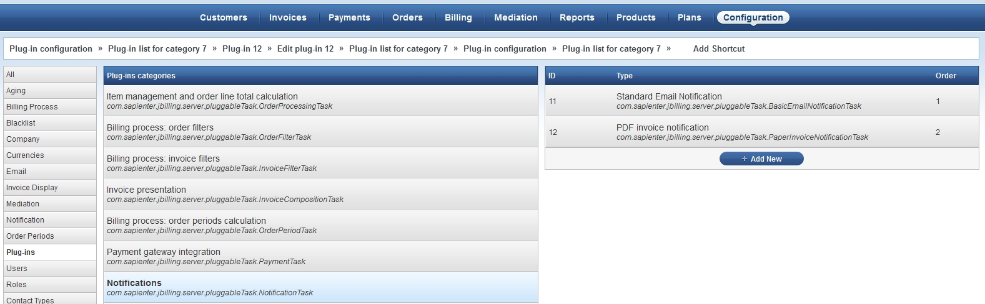
What do you need to know to be able to create one?
1
Configuration
Configuration -> Plug-ins -> Notifications -> PDF invoice notification
3
4
2

Slide 7
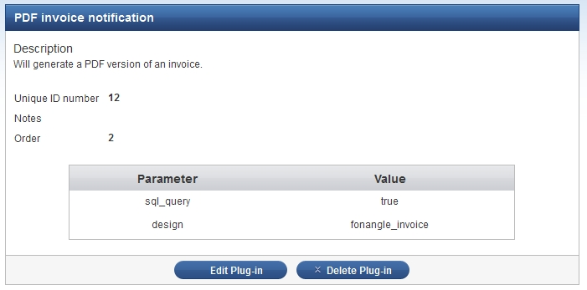
What do you need to know to be able to create one?
Configuration

Slide 8
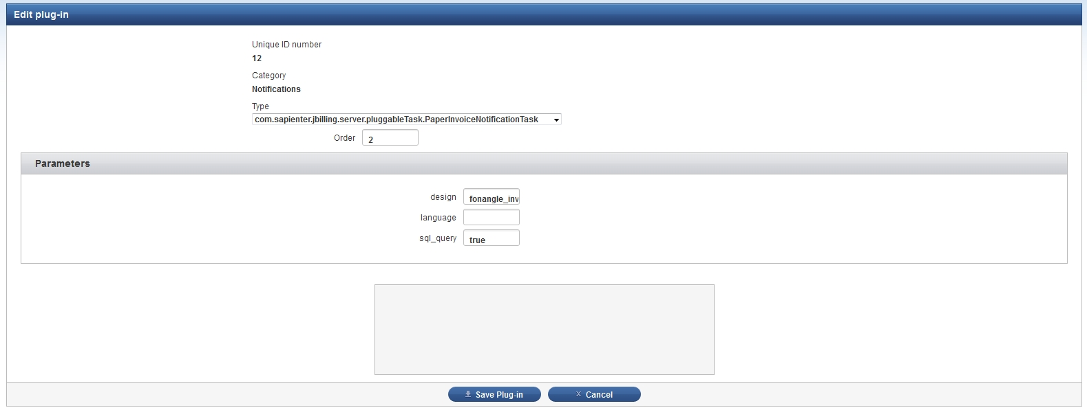
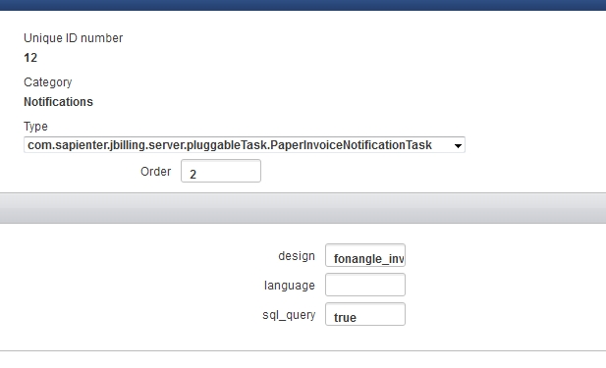
What do you need to know to be able to create one?
Configuration

Slide 9
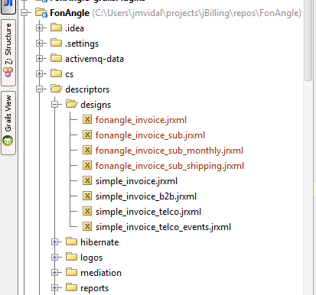
What do you need to know to be able to create one?
Invoice Directory
\descriptors\designs

Slide 10
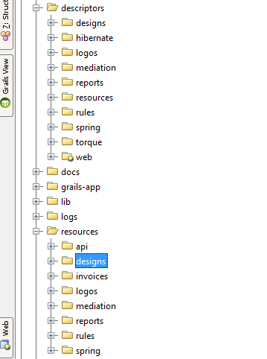
What do you need to know to be able to create one?
Grails Commands
Grails copy-resources
Grails compile-designs

Slide 11
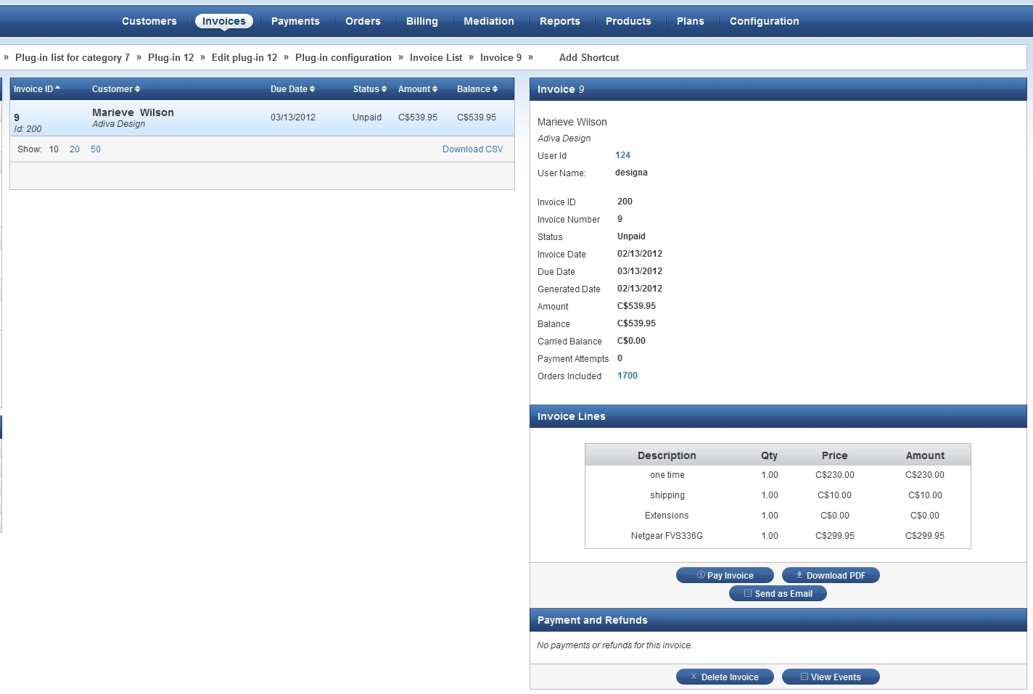
What do you need to know to be able to create one?
2
Using the Invoice
1
3

Slide 12
What do you need to know to be able to create one?
Creating the Invoice
Ireport
Report layout / bands
Parameters / variables / fields
Elements / properties
Sql query
Sub-reports / Tables involved
Version Compatibility

Slide 13
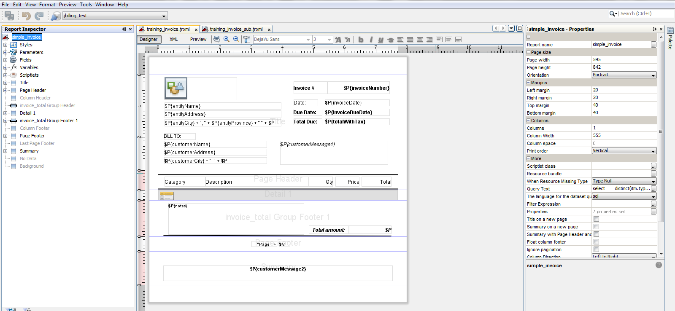
What do you need to know to be able to create one?
Creating the Invoice - iReport

Slide 14
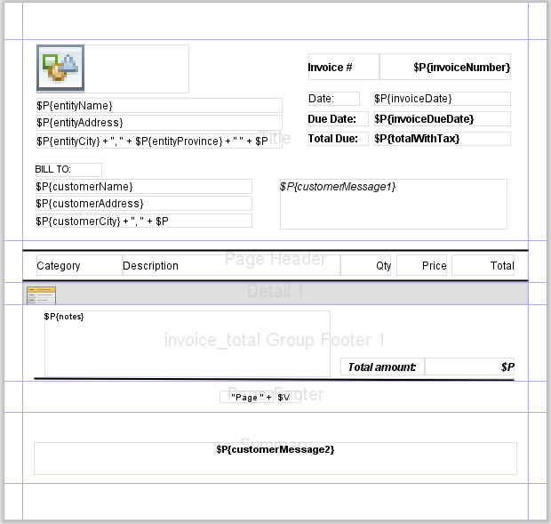
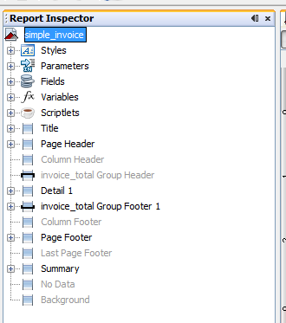
What do you need to know to be able to create one?
Creating the Invoice – Report Layout

Slide 15
What do you need to know to be able to create one?
Creating the Invoice – Parameters, Variables & Fields
These are objects that store values.
Parameters store values passed to the report from the calling program. ($P{param_name})
Fields store values retrieved from the datasource. ($F{field_name})
Variables store results of calculations such as sums, subtotals and son on. ($V{var_name})

Slide 16
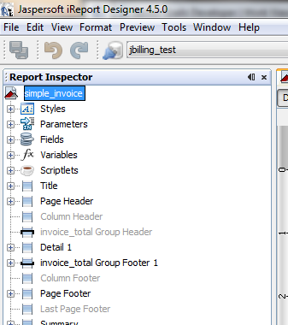
What do you need to know to be able to create one?
Creating the Invoice – Parameters, Variables & Fields

Slide 17
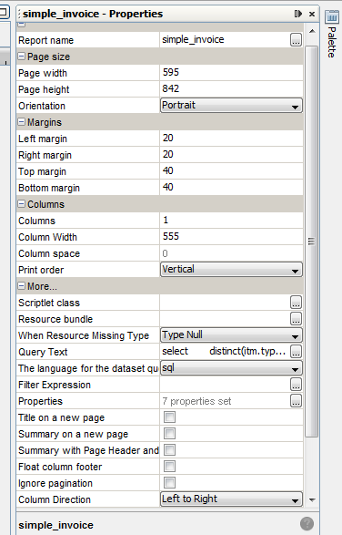
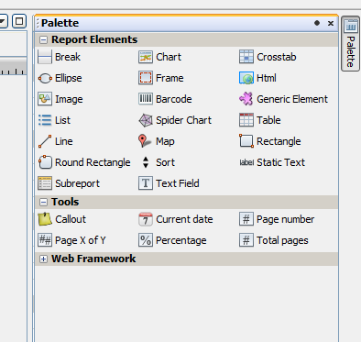
What do you need to know to be able to create one?
Creating the Invoice – Elements

Slide 18
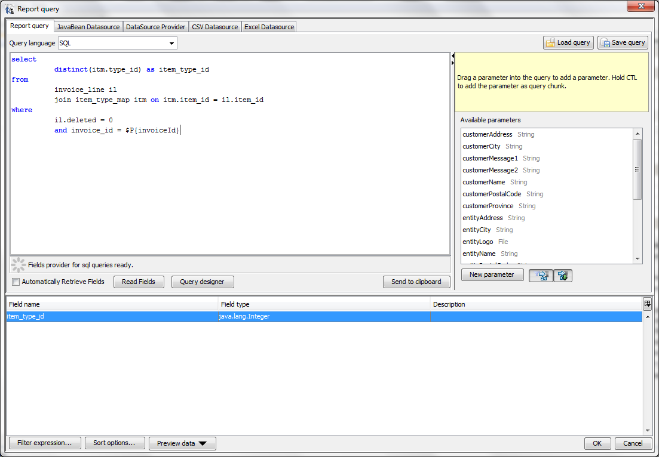
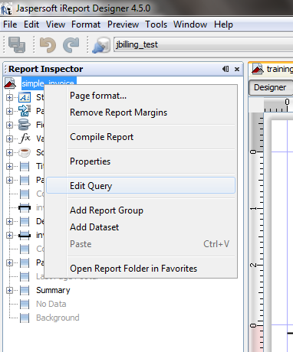
What do you need to know to be able to create one?
Creating the Invoice – SQL Query & Tables Involved

Slide 19
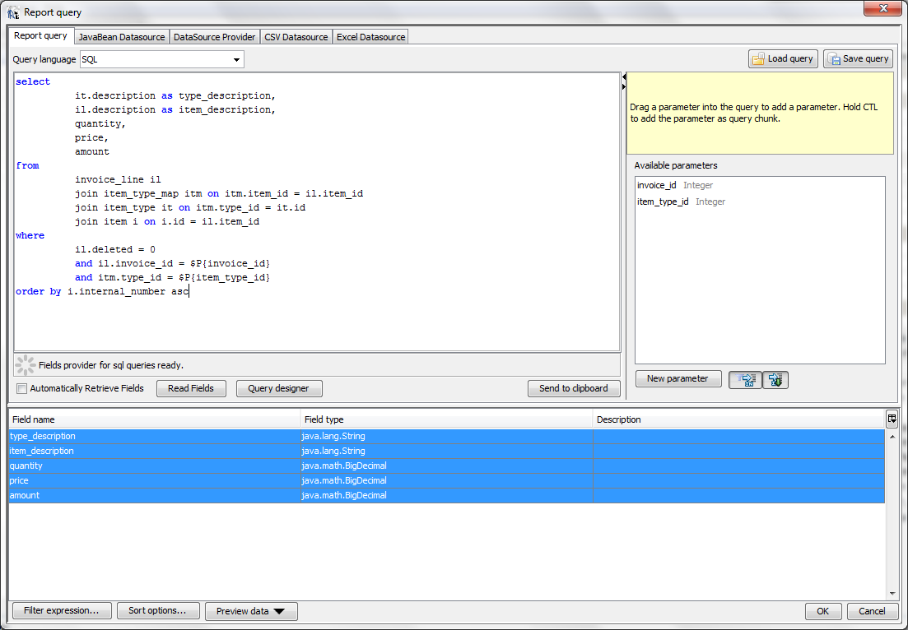
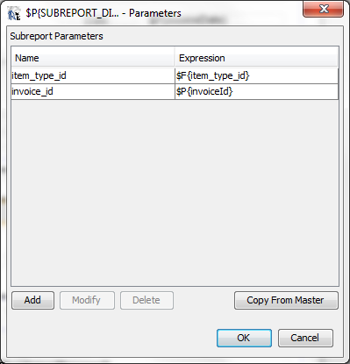
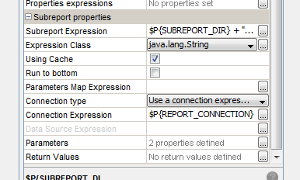

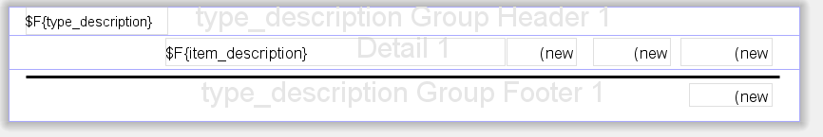
What do you need to know to be able to create one?
Creating the Invoice – Subreports & Tables Involved

Slide 20
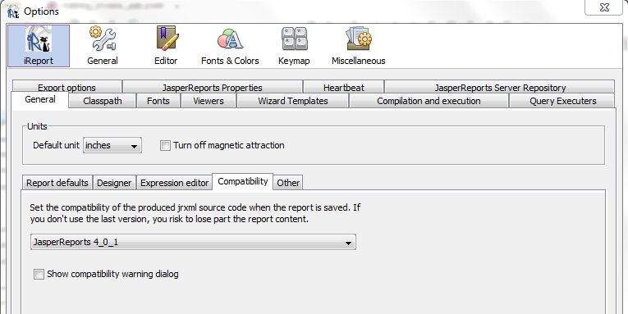
What do you need to know to be able to create one?
Creating the Invoice – Version Compatibility
Tools -> options -> general tab -> compatibility sub-tab
1
2
3

Slide 21
Example
Ireport

Slide 22
Test
Exercise 1
Add a new fields to the invoice (il.id).
Exercise 2
Change the sub-report to show the same information as before but only in one table (no grouping).
Exercise 3
Add your name right below the “total due” label situated in the title band.
Note: Do all the exercises in the same file with this name invoice_design_training.jrxml

Slide 23
Questions?

Slide 24
bookmarks
Jbilling wiki -> documentation section
The definitive guide to ireport – giulio toffoli – apress - 2007

